Slide 1
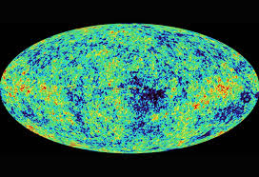

The mathematics behind the expansion of the universe.
Its history and open problems:
1.) For philosophical reasons Einstein considered a static cosmos. Called this his ‘greatest blunder’.
2.) The cause of this, dark energy, is one of the greatest open problems in theoretical physics, leading to the so called ‘worst prediction ever’.
3.) from these statements we can begin to appreciate the mysterious nature of this topic.

Slide 2
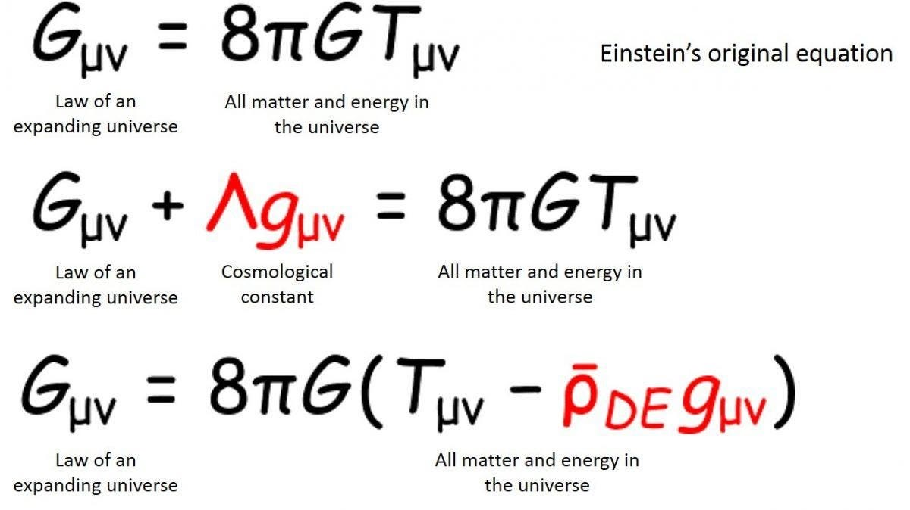
The abandonment of steady state theory regarding mathematics.
1.) Einstein originally modified the equations for general relativity as seen on this slide. This includes a cosmological constant.
2.) Russian physicist, mathematician and meteorologist Alexander Friedmann, who used pure mathematics to model numerous variable cosmological constants.
3.) This was pure mathematics, disconnected from the observations of Vesto Slipher, however.

Slide 3
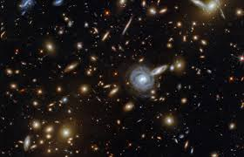
The abandonment of steady state theory regarding physics.
1.) The observations of Vesto Slipher were not fully understood to begin with.
2.) Lemaitre was among the first to seriously consider applying such notions to physical reality.
3.) Only when Hubble began to observe extra-galactic objects did, he note the redshift due to the doppler effect.

Slide 4
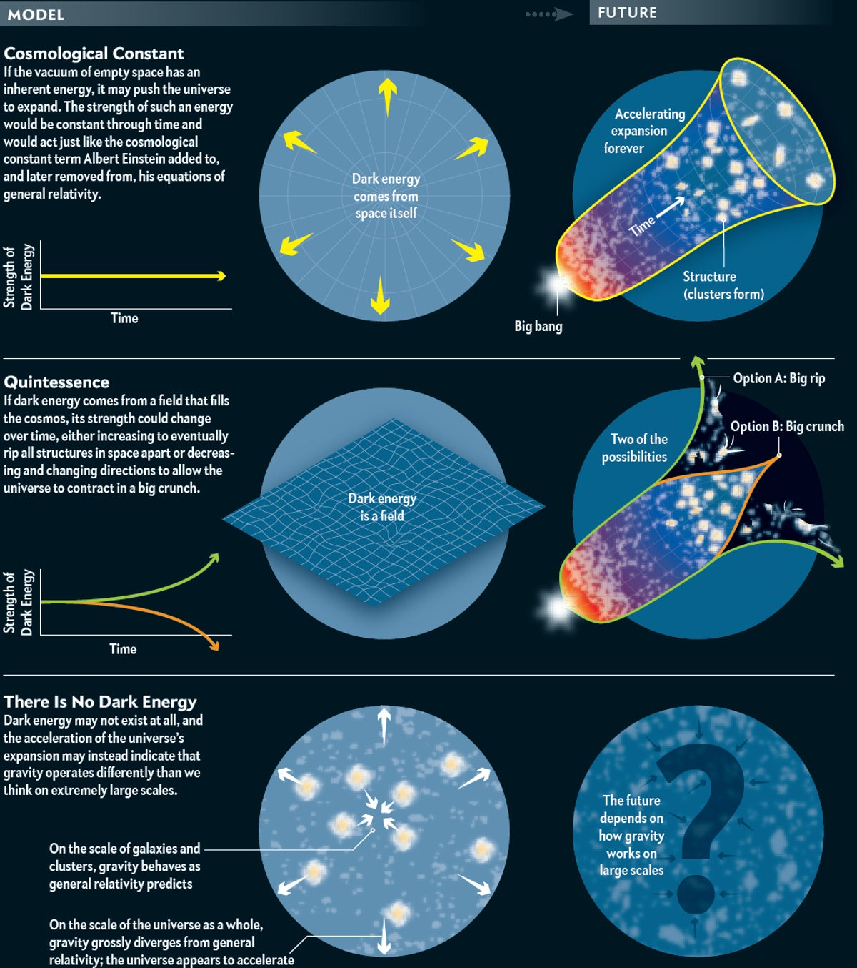
Contemporary observations
1.) In the 90’s the Nobel prize was given for the observation the universe is not only expanding, but that the expansion is accelerating.
2.) This is utterly contrary to the expected observation. Could it be due to the parameters within Friedmann's equations? Dark matter decay? A cosmological constant that simply is not constant due to some form of scalar field?
3.) This is as we don’t know what dark energy is and are furthermore usure as to what it even potentially could be.
4.) The idea it could be due to virtual particles has caused a discrepancy of 120 orders of magnitude. Further we are unsure if cosmic inflation occurred or what scalar field caused it.

Slide 5
References
Carruthers, T. (2018). Cosmic microwave background. [online] Curious. Available at: https://www.science.org.au/curious/space-time/cosmic-microwave-background. ( Accessed 28th Nov. 2024)
Siegel, E. (n.d.). This Is Why Einstein’s Greatest Blunder Really Was A Tremendous Mistake. [online] Forbes. Available at: https://www.forbes.com/sites/startswithabang/2019/10/29/this-is-why-einsteins-greatest-blunder-really-was-a-tremendous-mistake/. (Accessed 23rd October 2024)
Howell, E. (2018). How Many Galaxies Are There? [online] Space.com. Available at: https://www.space.com/25303-how-many-galaxies-are-in-the-universe.html. (Accessed 28 Nov. 2024).
Riess, M.L., Adam G. (2016). Dark Energy: No Answers but More Questions. [online] Scientific American. Available at: https://www.scientificamerican.com/article/dark-energy-no-answers-but-more-questions/. (Accessed 23rd Oct. 2024).
‌

